Slide 1
Self Efficacy
“Whether you think you can, or you think you can't--you're right.” -Henry Ford

Slide 2
In This Webinar
Identify student success factors
Define self-efficacy
Understand what affects self-efficacy
Identify what self-efficacy predicts
Understand what educators can do to impact self-efficacy

Slide 3
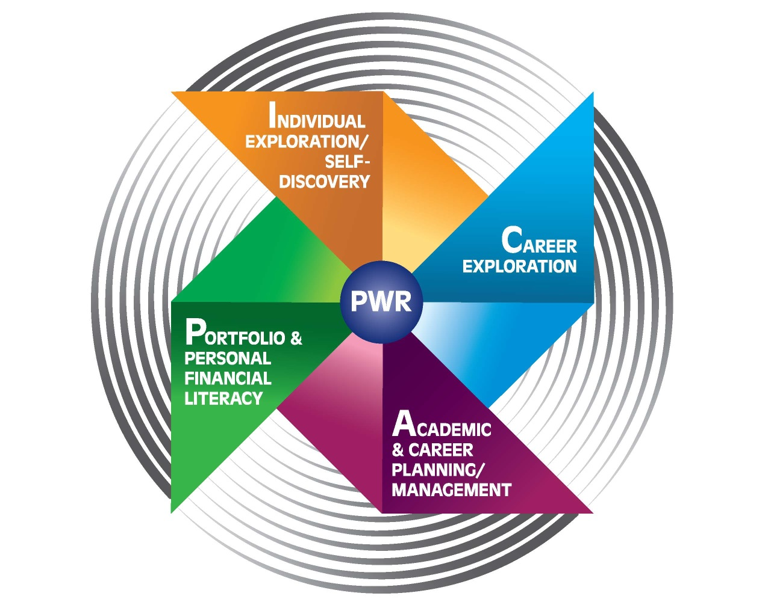

Slide 4
Individual Exploration
Personality and Strengths
Skills and Aptitudes - Roles
Roles, Occupations, and Vocations
Values
Passions
YOU!
Academic Innovations Bull's-eye

Slide 5
The MUSIC Inventory Constructs and Their Definitions
 | Definition
Constructs | The degree to which a student believes that:
eMpowerment | he or she has control of his or her learning environment in the course
Usefulness | the coursework is useful to his or her future
Success | he or she can succeed at the coursework
Interest (situational) | the instructional methods and coursework are interesting or enjoyable
Caring (academic and personal) | the instructor cares about whether the student succeeds in the coursework and cares about the student’s well-being
Brett D. Jones, 2014. Virginia Tech

Slide 6
MUSIC Model of Academic Achievement
eMpowerment - “Above all, be the heroine of your life, not the victim.” - Nora Ephron
Usefulness - “Any fact becomes important when it's connected to another.” - Umberto Eco
Success - In order to succeed, your desire for success should be greater than your fear of failure. - Bill Cosby
Interesting – “A sense of curiosity is nature’s original school of education” (Smiley Blanton)
Caring - “No significant learning occurs without a significant relationship” (James Comer)

Slide 7
Success
Students need to believe they can succeed if they put forth effort
Success
Increased Self-efficacy
Increased motivation - choice, effort, persistence)

Slide 8
Let’s Start with a Quiz
On a scale of 1-5
1 = not confident
3 = somewhat confident
5 = very confident
How confident are you that if asked run:
100 yards
5k
a marathon

Slide 9
Saturday

Slide 10
Predicts Achievement and Performance
Definition:
“Perceived capabilities for learning or performing actions at designated levels”
(Schunk and Pajares, 2009, p. 35 based on Bandura, 1997)

Slide 11
What factors affect self-efficacy?
*Past/Actual Performance
Vicarious Experiences
Social Persuasion
Physiological Indexes
*Most important
Brett D. Jones, 2012. Virginia Tech

Slide 12
Past/Actual Performance
Travis Pratt

Slide 13
Vicarious Experiences
Bethany Hamilton

Slide 14
Social Persuasion
Po

Slide 15
Physiological Indexes
ANXIETY
STRESS
Mr. Bean

Slide 16
What Does Self-Efficacy Predict
Motivation
Learning
Self-Regulation
Achievement
Brett D. Jones, 2012. Virginia Tech

Slide 17
Ideas related to self-efficacy
A high level of self-efficacy does not compensate for lack of ability
Having self-efficacy a little above ones true ability is ok, and probably ideal as it leads to more positive outcomes than lower self-efficacy.
Too high self-efficacy can be problematic
Students make choices based on other things beyond self-efficacy like values
Brett D. Jones, 2012. Virginia Tech

Slide 18
How is self-efficacy different from other psychological concepts?
Self-efficacy - Perceived capabilities for learning or performing actions at designated levels” (Schunk and Pajares, 2009, p. 35 based on Bandura, 1997)
Self-concept – one’s perception of herself, including ability-related perceptions and feelings about those ability-related perceptions (Bong and Skaalvik, 2003)
Global self-esteem – an overall evaluation of the self as a person of worth (Rosenberg, 1979)

Slide 19
Self-concept is multidimensional and hierarchical
General Self-Concept
Academic
Reading
Math
Physical
Communication Skills
Science
Peers
Social
Athletic Ability
Attractiveness
Self-esteem
Self-efficacy
Brett D. Jones, 2012. Virginia Tech

Slide 20
Quiz – Label the following as self-efficacy, self-concept or self-esteem
“I can put my ideas into writing”
“On the whole, I am satisfied with myself”
“I am good at science”
“I’m confident I can choose an appropriate formula to solve a chemical problem”

Slide 21
Quiz – Label the following as self-efficacy, self-concept or self-esteem
“I can put my ideas into writing” – Self-efficacy
“On the whole, I am satisfied with myself” – Self-esteem
“I am good at science” – Self-concept
“I’m confident I can choose an appropriate formula to solve a chemical problem” – Self-efficacy

Slide 22
Academic Achievement
Self-efficacy – high correlation
Self-concept – some correlation
Global self-esteem – no correlation
The connection between self-efficacy and achievement gets stronger as students advance through school. By the time students are in college, their self-efficacy beliefs are more strongly related to their achievement than any measure of their ability. If we wish to develop high educational achievement among our students, it is essential that we begin building stronger self-efficacy as early as possible.
Albert Bandura, 1986

Slide 23
How can educators foster self-efficacy
Past/Actual Performance
Vicarious Experiences
Social Persuasion
Physiological Indexes

Slide 24
Strategies
Provide students with meaningful choices as to the topics they can study, the materials they can use, the strategies they can implement, and/or the students with whom they can work.
Allow students to control the pace of the lesson
Provide rationales for rules and directions –typing
Explicitly state to students how the material is related to their interests, career goals, and/or the real world.
Provide opportunities for students to engage in activities that demonstrate the usefulness of the content to their future career or in the real world. Service learning activities

Slide 25
Make the expectations for the course activities clear and explicit.
Provide clear and understandable directions for all assignments.
Divide longer or more complex learning activities into manageable sections that challenge, but do not overwhelm students.
Think broadly about ways in which they can provide feedback to students. – twitter
Include any of the following elements into activities to enhance the situational interest: novelty, food, social interaction, games and puzzles, fantasy, humor, narrative, physical movement, or content related to injury, sex, or scandal
Show concern for students’ successes and failures. One way to accomplish this is to stay in touch with your students on a fairly regular basis

Slide 26
Compliment Students on the Skills They Develop
Help Students Practice Lack-of-Effort Explanations for Poor Performance
Avoid the Appearance of Unsolicited Help
Promote Recognition of Progress During a Lesson
Help Students Set Goals
Help Students Document Their Growth
Use Peer Models
Help Students Serve as their Own Model

Slide 27
Self-efficacy and Student Motivation

Slide 28
Leah Morgan

Slide 29
Questions
In your current practice, how can you develop self-efficacy with the students with whom you work?
What are three key concepts you learned today?
What would you like to know more about?

Slide 30
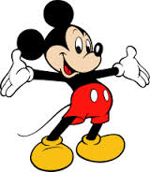
"It's kinda fun to do the impossible."
~ Walt Disney ~

Slide 31
Resources
http://www.gifted.uconn.edu/siegle/selfefficacy/section1.html University of Conn website
http://p20motivationlab.org/ University of Kentucky website on self-efficacy
Self-Efficacy in Sport, by Deborah Feltz, Sandra Short, and Philip Sullivan. [See the Announcement!]
Academic Motivation of Adolescents (chapter on self-efficacy by Prof. Schunk). Also see
International Perspectives on Adolescence.
General Issues on the Education of Adolescents.
Educating Adolescents: Challenges and Strategies.
Prof. Bandura's Self-efficacy: The Exercise of Control.
Description and chapter contents.
Chapter outline, created by Prof. Giovanni Valiante, Rollins College.
Reference List, provided by Prof. Bandura (html document).
Complete draft of Chapter 6 - Cognitive Functioning.
Prof. Bandura's Social Foundations of Thought and Action: A Social Cognitive Theory.
Have a look at selected passages from this book.
Missing pages 496-497 from later editions of this book.
In Spanish by Martinez Roca, Barcelona (Pensamiento y accion, #84-270-1162-8).
Prof. Bandura's Self-Efficacy in Changing Societies.
Published in Spanish by Desclée De Brouwer, Bilbao
Prof. Bandura's Social Learning Theory.
Prof. Zimmerman's Developing Self-Regulated Learners.
ο Professor Zimmerman has a first-rate chapter in Pajares and Urdan's book on academic motivation.
ο And another chapter in the new self-efficacy volume.
Prof. Valiante's outstanding new book Fearless Golf - self-efficacy brought to sports.
James Maddux's Self-Efficacy, Adaptation, and Adjustment.
ο Description and chapter contents.
Ralf Schwarzer's Self-Efficacy: Thought Control of Action.
M. J. Kernis's Efficacy, Agency, and Self-Esteem.
Self-Efficacy in Nursing, edited by Lenz and Shortridge-Baggett
Michael Aleksiuk's, Power Therapy: Maximizing Well-Being Through Self-Efficacy.
And here is Caprara and Cervone's Personality: Determinants, Dynamics, and Potentials .
Also see Richard Evans' Albert Bandura: The Man and His Ideas - A Dialogue.

