Slide 3
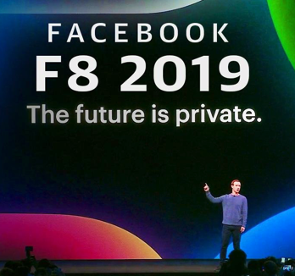
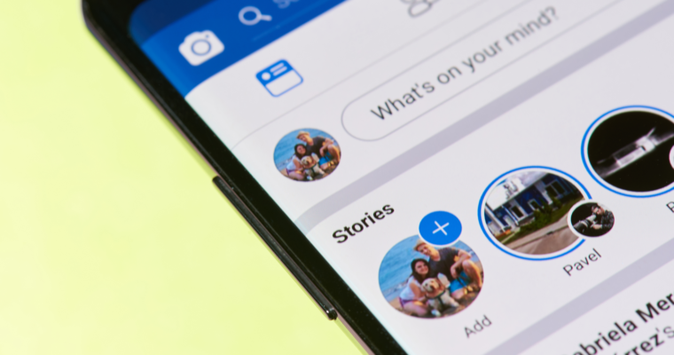
May News Recap
Facebook F8 Conference
Automated Ads
Video Editing Tools
Story Users Increase to 500 Million
Messenger Updates
Lead Form Templates
Appointment Booking
Desktop Version

Slide 4
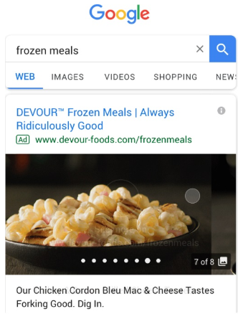
May News Recap
Google Marketing Conference
Visual Mobile Ads
AI Generated Bumper Ads
Hyper-Local Advertising
Mobile-First Index Begins July 1st
Core Algorithm Update June 4th

Slide 5
May News Recap
Other News
Retweet with photos, videos, and GIFs
Google starts SEO YouTube series –
SEO Mythbusting
Mailchimp launches full marketing platform

Slide 6
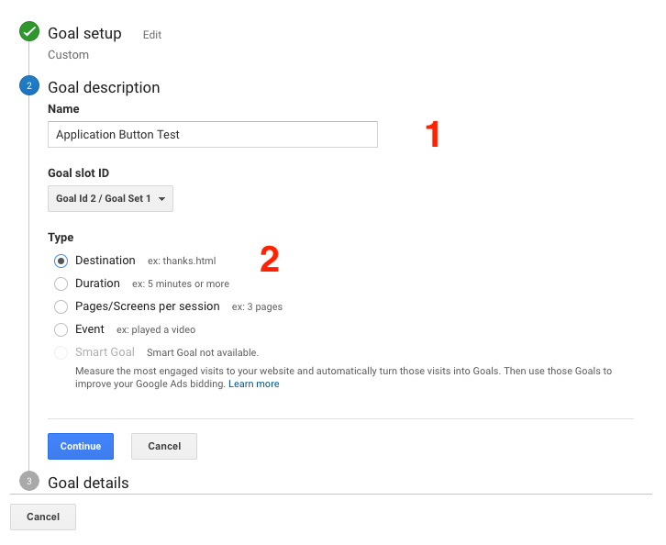
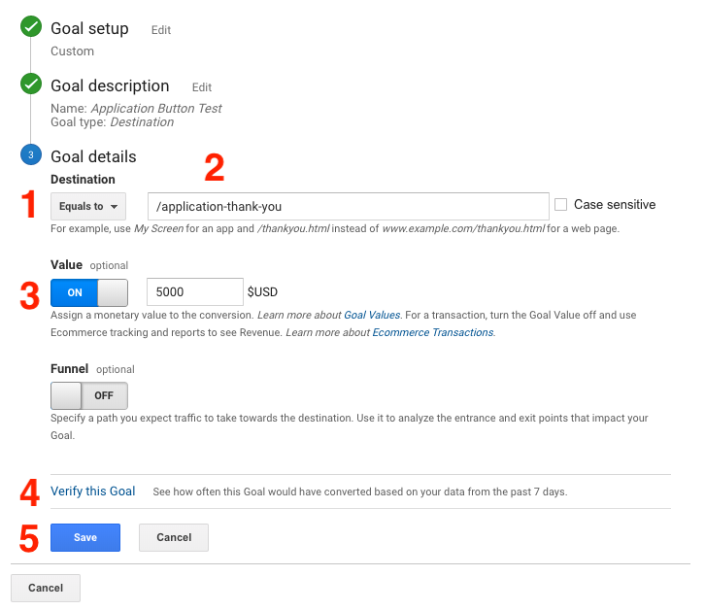
3.
Google Analytics
How to Create Goals
Admin > View > Goals > New Goal
Goal Setup > Custom
Goal Description:
Add Name
Select Destination
Goal Details:
Set Destination to “Equals to”
Enter final URL (only use last portion of URL i.e “/application-thank-you”)
Add a monetary value if you have one
Click “Verify this Goal” to test if it is working
Click “Save”
4.

Slide 7
Open Discussion

