Slide 1
HANDLING PURCHASES AT CCCS
January 2023

Slide 2
PROCUREMENT CODE OF ETHICS
Any person employed by the State of Colorado who purchases goods and services, or is involved in the purchasing process, for the state, shall be bound by the code.
Avoid the intent and appearance of unethical or compromising practice in relationships, actions, and communications.
Refrain from any private or professional activity that would create a conflict between personal interests and the interest of the State.
Never solicit or accept money, loans, or prejudicial discounts and avoid the acceptance of gifts from suppliers.
Provide an environment where all business concerns are afforded an equal opportunity to compete for State of Colorado business.

Slide 3
Why are there so many rules? To ensure compliance with State of Colorado Fiscal Rules, Procurement Code, Personnel Rules, System Policies and Procedures. To ensure every procurement is documented appropriately. To abide by the State of Colorado Code of Ethics To work smarter, not harder.
State Procurement Code
State Fiscal Rules
State Personnel rules
Federal Funds rules and IRS - sometimes

Slide 4
FIRST THINGS FIRST

Slide 5
Forms, Forms, Forms

Slide 6
Why are there so many forms?
To be good stewards of tax payer dollars
All financial transactions are subject to audit
To establish careful controls and authorities
Forms can be found on the CCCS Website under Finance

Slide 7
AUTHORITIES AND APPROVALS
Everyone who spends money must have the authority to do so.
Org Code Signature Delegation form submitted annually
Written authority to use non-delegated orgs
Many of the things we spend money on need to be approved in advance:
Approval Request Forms
IT Approvals – contact ITPurchasing@cccs.edu
Furniture – except for chairs (must be black) and Varidesk sit/stand units
Notes:
Are these forms on the web?

Slide 8
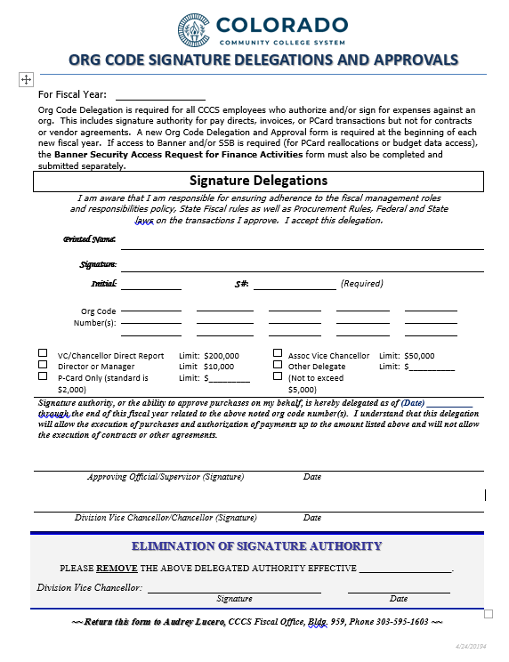
Org Code Signature Delegation & Approval
Required for all staff who will sign for expenditures on an org​
A new form is required annually​
This form requires original signatures
Submit to Audrey Lucero

Slide 9
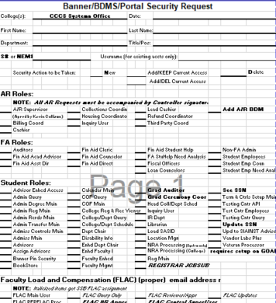
Banner Security Finance Role
Required for general log-in access to Banner​
Provides Banner access to the finance screens​
Purchasing will handle this form for PCards
Contact Karen Vazquez for other access needs

Slide 10
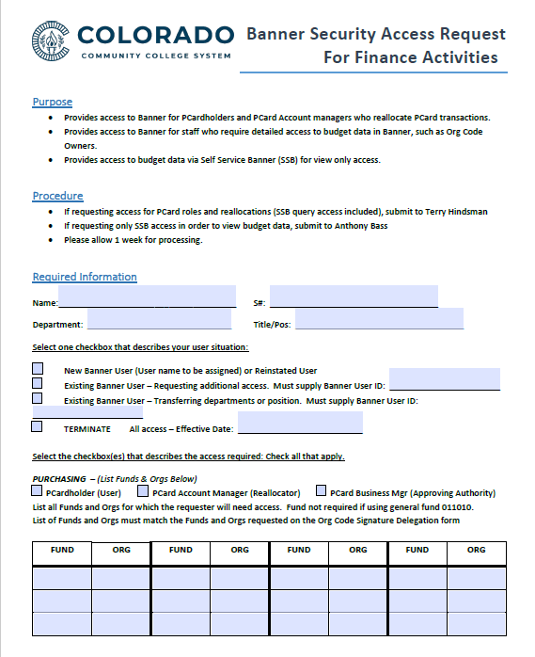
Banner Security Access Request for Finance Activities
Also known as FOMPROF access
Required to access specific org and fund data in Banner​
New form required for any new org or funds​
Contact: Terry Hindsman

Slide 11
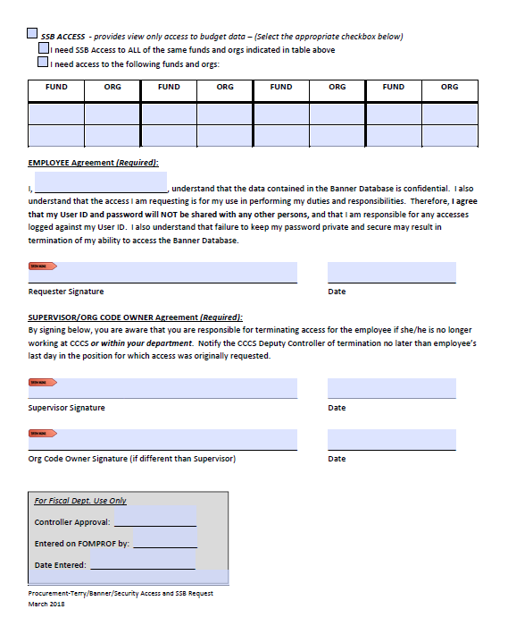
Banner Security Access Request for Finance Activities
Continued​
​
Don't forget the Org Code Owner if that's different than the Supervisor

Slide 12
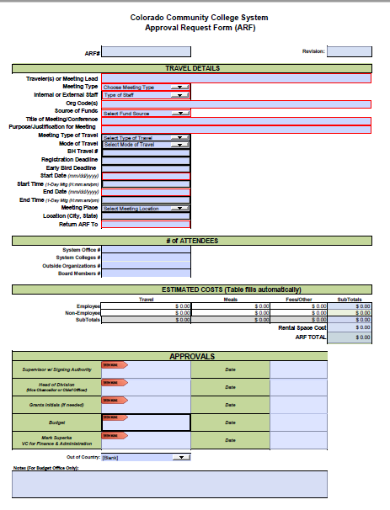
Approval Request Form
Required for webinars, classes, travel, meetings with food
Events of $100 or less need Supervisor signature only​
Online trainings of $250 or less need Supervisor signature only.
Complete all pages and attach any additional documents​
Submit to Marie Mueller

Slide 13
A Note on Signatures
Finance is required to ensure that virtual signatures are secure and verified​
Current process requires:​
Original Signature (then scan and send)​
OR, If electronic,​
Email from the signer(s) with explicit approval​
I, Minnie Mouse, approve the attached purchase req for ABC Company in the amount of $5,000.
The Signature Delegation form is the only form requiring original signature only.

Slide 14
Considerations in Purchasing

Slide 15
Every Purchase Has Two Pieces
Procurement
how you choose your vendor
Fiscal
how you pay for it
Each piece has its own rules, forms and processes

Slide 16
General Considerations
Do you have the authorities needed? (Signature delegations, ARF, email)​
Do you have sufficient budget? ​
Is there a clear business purpose?​
Did you ensure there is no Colorado sales tax?​
Is the purchase for the personal use or benefit of an individual?

Slide 17
Pre-Approvals
These items will require that you obtain a pre-approval:​
IT related – includes software, hardware, electronic devices and accessories. Contact Mario Montoya at ITPurchasing@cccs.edu
Furniture - Black office chairs are OK. Otherwise, contact Purchasing
Webinars, conferences, classes, professional development of any amount, require an ARF.​
Meetings involving food or other expenses require an ARF​
Travel other than mileage only requires an ARF

Slide 18
A Note About Software
Gone are the days that software came on disks. ​
Most software today is accessed online, rather than downloaded to your computer, and often called an app, subscription or maybe Software as a Service (SaaS). ​
It is all still software and requires IT Approval.
This Photo by Unknown author is licensed under CC BY.

Slide 19
Prohibited Purchases
What do you think would be prohibited purchases?
Put your answers in the chat

Slide 20
Prohibited Purchases
Gift cards​
Alcohol​
Items for personal benefit​
Advance payments​
Split Purchases​
Purchases with vendor agreements​
Foreign Vendors – need approval

Slide 21
Purchasing Limits To Keep In Mind
Type of Limit | Total Dollar Amount | Process – for goods and services
Discretionary Purchase | $0-$5,000 | Check price agreements first (www.bidscolorado.com) May use vendor of choice Maintain invoices, receipts, etc. Payment via PCard or Pay Direct FOR SERVICES: if vendor not on approved vendor list, submit a Purchase Requisition to generate a Payment Authorization for Services (PAS).
Purchase Order Required | $5,000 and higher | Check price agreements first May use vendor of choice up to $50,000 Submit a Purchase Requisition (PR) to generate a Purchase Order PO must be in place before starting work or placing an order.
Solicitation Required | $50,000 and higher | Contact Purchasing to determine the best type of solicitation for the need. After award, determine if a contract is needed. Submit a Purchase Requisition (PR) to generate a Purchase Order

Slide 22
Price Agreements
Price agreements are contracts that the State has put in place for categories of goods and services used frequently by state agencies.
Examples:
Office Supplies: Staples and Office Depot
Toner: Beyond Technology
Computer Software and Hardware
Translation and Transcription Services
Marketing and Advertising Services
A full list can be found at www.bidscolorado.com

Slide 23
Goods VS Services
Goods are physical items that are manufactured, stored and sold. No participation in the production. Examples: office supplies, books, tractors, computer hardware
Services are produced by an individual’s performance. Participation in the production process can be significant. Examples: customization of items for CCCS, guest speakers, conference space rentals, sign language interpretation, conference facility rentals
A list of Approved Service Vendors is located on the Finance page of the CCCS Website. Submit a Purchase Requisition to use other vendors.

Slide 24
Independent Contractor vs Employee
Be very careful when hiring and paying individuals.
CCCS employees must be paid through the payroll system, not through the purchasing process.
Former CCCS employees and other state agency employees may have PERA considerations
Always contact Purchasing and/or HR before hiring a self-employed individual.

Slide 25
Purchase Orders
Required for all purchases over $5,000. ​
Purchase Order must be in place before the funds are committed (starting work or placing order).​
Submit a Purchase Requisition (PR) to Purchasing completing all fields. ​
Plan for a minimum of 2 weeks for processing
Remember: you are the manager of your PO. It is up to you to keep tabs on payments as well as vendor performance.

Slide 26
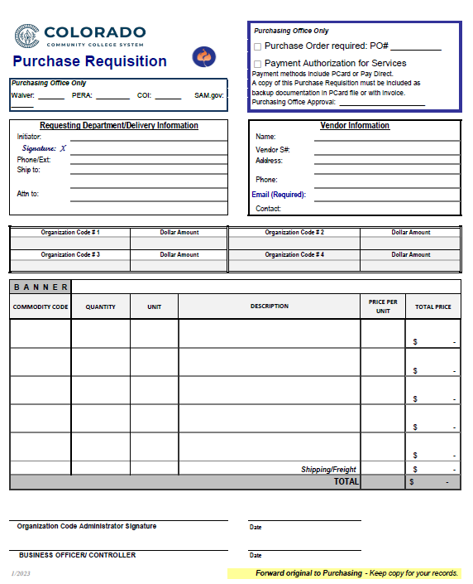
Purchase Requisition (PR)
c
c
c
c
c
c
Required for Services of any amount​
Attach back up documents including:​
Quote or SOW​
ARF​, if applicable
W-9, if new vendor​
Attached invoices will not be sent to AP
Allow 2 weeks to process
c
c

Slide 27
Change Orders for POs and PAs
Purchase Orders –
Increased amounts – requires a new PR
Include the current amount of the PO and add new line for the additional amount needed.
Include quotes or other backup
Decreases and non-dollar changes – can be done with an email.
Payment Authorizations –
Can be done with an email
Include quotes or other backup

Slide 28
Finance’s Process for Purchase Requistions
Check for required documents – follow up with requester or vendor as needed
W-9
Approval Request Form
Scope of Work or quote
PERA Retiree information & forms
Certificate of Insurance
Check for appropriate org and commodity code
Check that the approver has appropriate authority/delegation for the dollar amount and org code
Obtain sign off from grants for use of all 13xxxx orgs
Check for federal grants requirements as needed (SAM)
Check to ensure there is sufficient budget
Obtain approval from controller

Slide 29
Paying Invoices against Purchase Orders
When processing invoices for payment against a PO, please include the following information with the invoice: ​
Signature to indicate receipt of the goods or services and approval to pay​
PO number, if it's not provided on the invoice​
Applicable line numbers (for multi-line invoices)​
Submit invoices to AP for processing.
Once the last invoice for a PO is received, mark the invoice as “final” and we will close it.

Slide 30
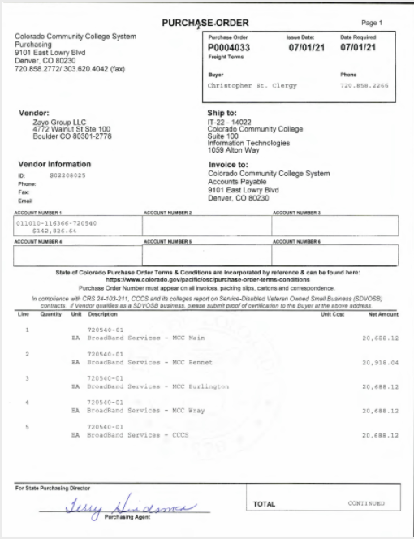
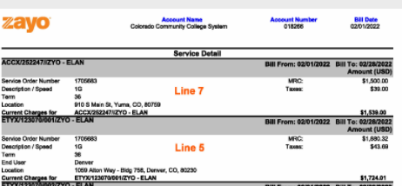
Example of Multi-Line Receiving

Slide 31
Paying for Small Purchases less than $5,000
PCards​
Have a single purchase limit of $2,000. ​
Temporary increases can be done for purchases between $2,000-$5,000. Contact Purchasing to request a temporary increase.​
Invoice Direct Pay ​
Provide the appropriate vendor S#, org code and account or commodity on the face of the invoice. ​
Sign off to indicate receipt of the goods or services and approval to pay. Submit to AP for processing.​
​
Note: the use of PCards is governed by additional rules and processes covered during a specific PCard training provided when the PCard is issued. This training is also required for Supervisors who serve as the Approving Authority for a PCard-holder. Please contact Purchasing to get the training you need.

Slide 32
What are your take-aways?
What do you think are the 2 most important things to remember about purchasing?​
Please put your take-aways in the chat box.

Slide 33
Helpful Contacts

Slide 34
Questions?
Did I leave anything out?

