Slide 3
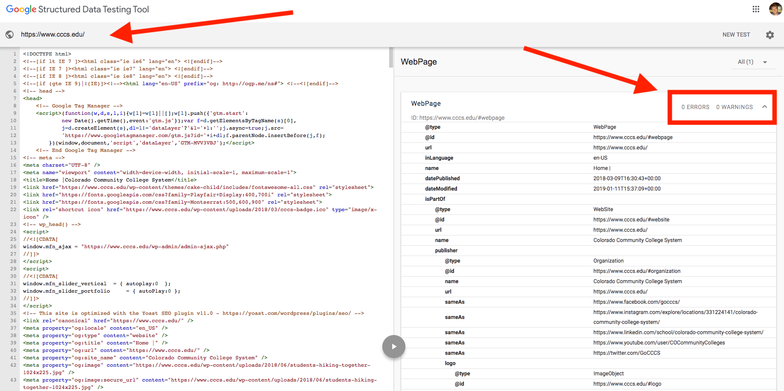
April News Recap
Yoast SEO Plugin Schema Update
Check Schema Code Here
Great for Voice Search
By 2020, 50% of
searches will be
voice
Articles:
Search Engine Journal
Yoast

Slide 4
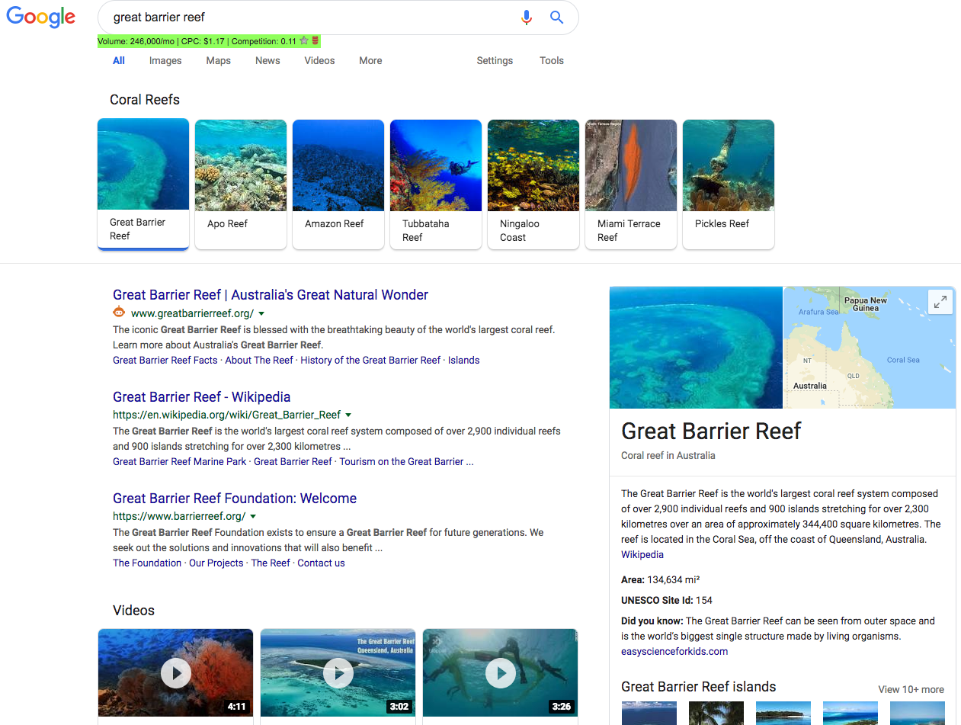
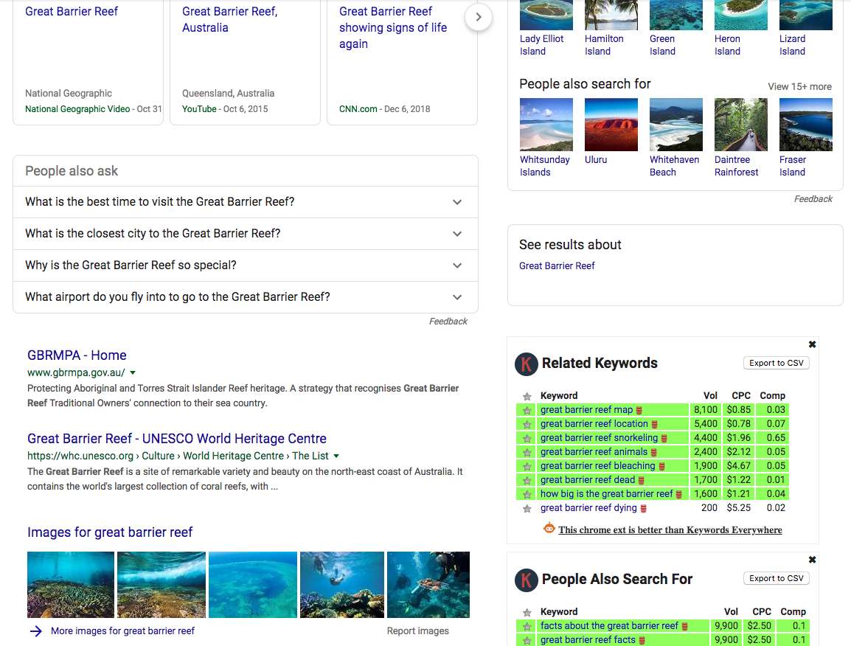
April News Recap
Google To Start Showing More Images In The SERP’s
Image box shows for 34% of all search queries. Article here
SEO Image Optimization Tips:
Search Engine Land
Yoast
AHrefs

Slide 5
April News Recap
Facebook To Merge Messenger, WhatsApp, & Instagram Messages
Zuckerberg Explains Why on Mashable.com

Slide 6
April News Recap
Twitter’s “Hide Reply” Feature Comes Out In June
Twitter Blog Announcement

Slide 7
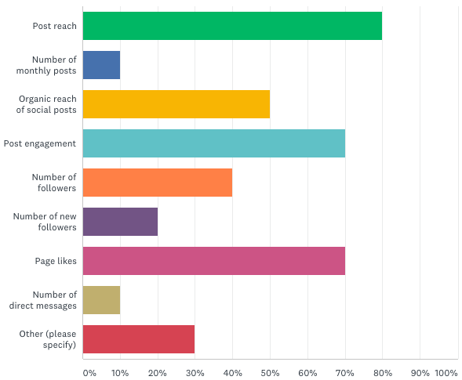
Marketing Metrics Survey
What type of social media marketing metrics should we be tracking to best measure ROI?
Top 3:
Post Reach
Post Engagement
Page Likes

Slide 8
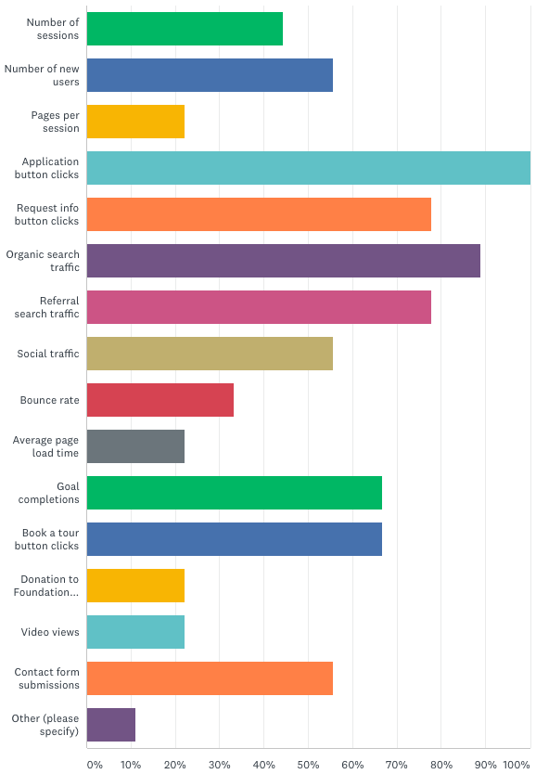
Marketing Metrics Survey
What type of website metrics should we be tracking to best measure ROI?
Top 3 (two tied):
Application Button Clicks
Organic Search Traffic
Request Info Button Clicks (Tied)
Referral Search Traffic (Tied)

Slide 9
Open Discussion

